Slide 1


MSIS 2802 - Data Science Analysis with Python
Project Fly
Omkar Gokhale Mohit Kudalkar

Slide 2


Data
Flights - US only
Weather - Top 10 Cities

Slide 3



Date
Location (City, State)
Temperature Avg (ºF)
Dew Point Avg (ºF)
Wind Speed Avg (mph)
Humidity Avg (%)
SeaLevel Pressure (inches)
Visibility Avg (miles)
Flight Date
Source City
Destination City
Carrier
Departure Delay
Arrival Delay
Cancellation Flag
Diversion Flag
Cancellation Reason etc.

Slide 4

Cleaning
Replacing un-identifiable characters
Replacing nulls with different methods
Converting data types

Slide 5

Data Wrangling and Merging
Duplicate weather data
Merge flight and weather data

Slide 6
ORIGIN_TempAvg
ORIGIN_DewAvg
ORIGIN_WindAvg
ORIGIN_HumAvg
ORIGIN_SeaLevelAvg
ORIGIN_VisibilityAvg
DEST_TempAvg
DEST_DewAvg
DEST_WindAvg
DEST_HumAvg
DEST_SeaLevelAvg
DEST_VisibilityAvg

Slide 7


Machine Learning Techniques
Classification for predicting flight cancellation
Clustering for estimating the primary parameter for grouping flights
Regression for prediction of arrival delay

Slide 8

Insight 1 : Flight Cancellation
A flight is most likely to be cancelled when:-
Humidity at source city is low,
Humidity at destination city is high
Wind speed at destination is high.
A flight is mostly cancelled when the humidity at the source is high and the wind speed is also high.
Interestingly, a flight is mostly not cancelled when the above parameters apply for flights with more Airtime.

Slide 9
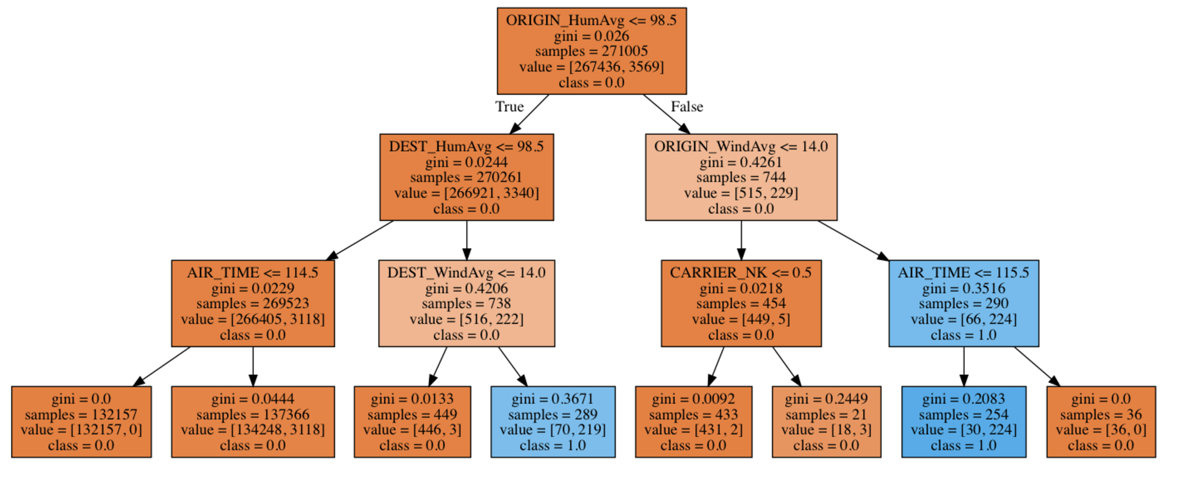
We are getting close-to-perfect classification..
So, let’s stop at depth = 3

Slide 10




Delay
Distance
Insight 2 : Clustering
Shorter the distance of the flight, greater is the delay in the arrival of the flight.
The clusters are based on the primary parameter of distance and air-time; weather data doesn’t have any strong impact on clusters.

Slide 11
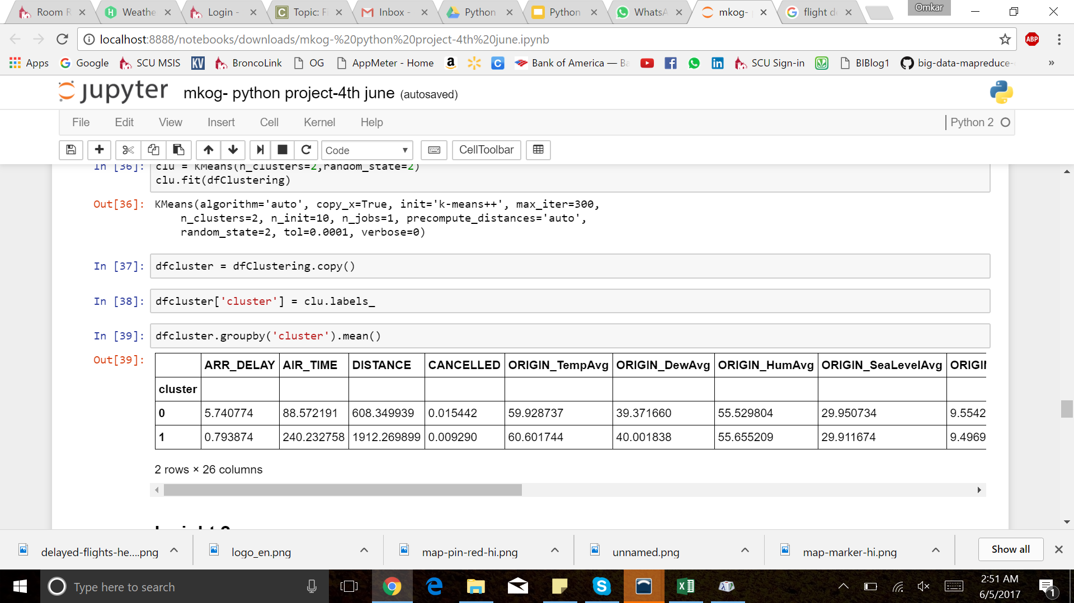
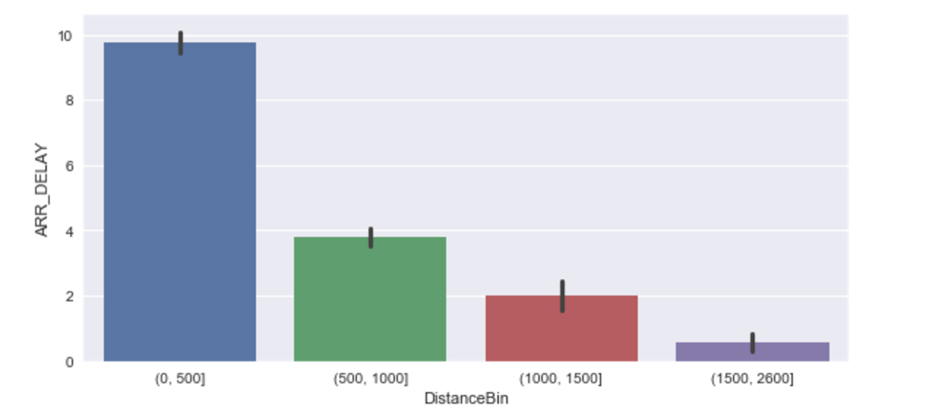

Slide 12


Insight 3 : Delay Prediction
If Sea Level Pressure at source city is high, and Visibility at source city is less, then delay is high.
With the same conditions for Sea level pressure, if visibility at source city is more, the delay is negative. (Flight actually arrives early!!)

Slide 13
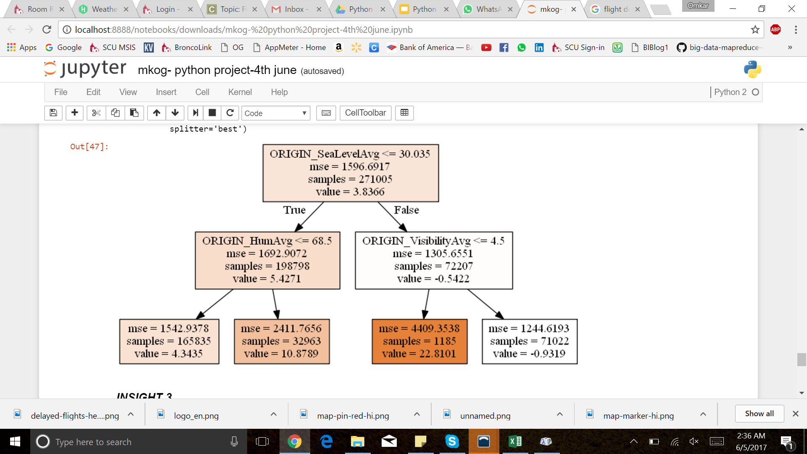

Slide 14
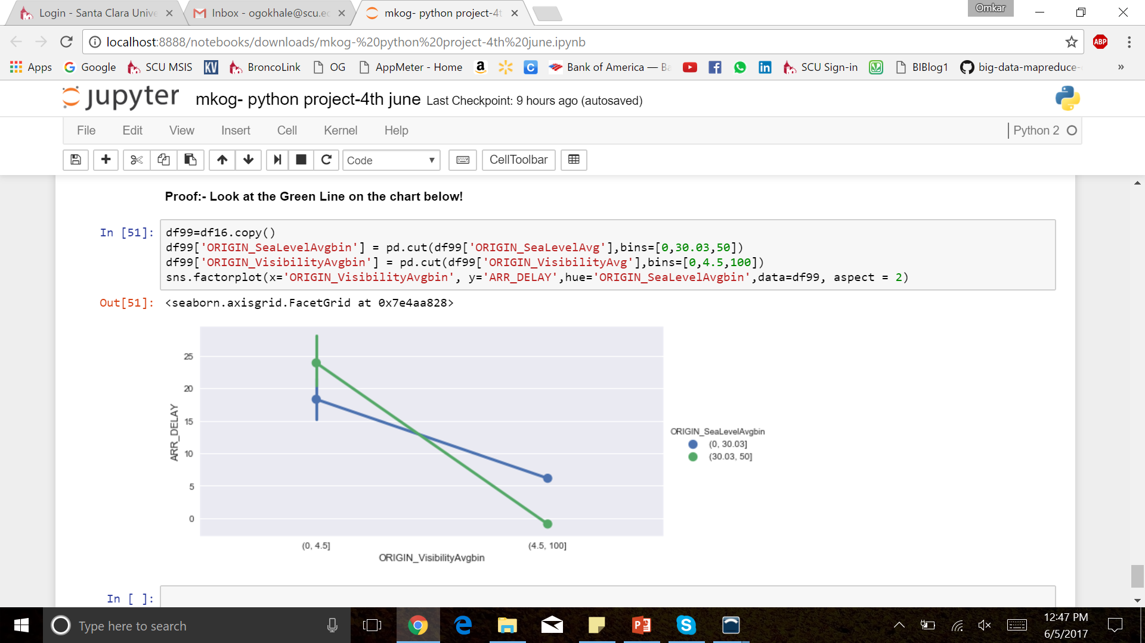
This chart supports Insight 3.

Slide 15
Challenges
Availability of Data
Data Quality
Data Type issues while running models
Finding Interesting Insights (I think you’ll agree!)

Slide 16
Thank you!
Omkar Gokhale Mohit Kudalkar

